Slide 1

Code modernization a practical approach HPC-TNT-1.2 january 2018 Annie Cuyt ☐ Stefan Becuwe ☐ Franky Backeljauw ☐ Kurt Lust ☐ Engelbert Tijskens

Slide 2
Goal
A practical approach
To build efficient applications
To understand performance issues
To maximize code flexibility
To minimize coding efforts

Slide 3
Overview
Some computer architecture concepts related to performance and machine limits
Levels of parallelism → peak performance
Memory on modern CPUs → bandwidth, latency
Example1 [toy problem]
Atomic system interacting through a Lennard-Jones potential
Monte Carlo setting
Example 2
Atomic system interacting through Lennard-Jones potential
Molecular dynamics setting
Optimizing code ⇔ optimizing data access
Spatial sorting using space filling curve
Choosing a programming language

Slide 4
Levels of parallelism
A little bit of “cluster” terminology
A (compute) node in a cluster is basically a PC without all the peripheral devices
Nodes are connected through a fast network: interconnect
Every node has several sockets, each of which contains a processor
Every processor contains many cores
Each core can simultaneously execute one task: thread
Simultaneous multi-threading : more than one thread per core
Usually switched off on clusters
Thread executes a sequential stream of instructions

Slide 5
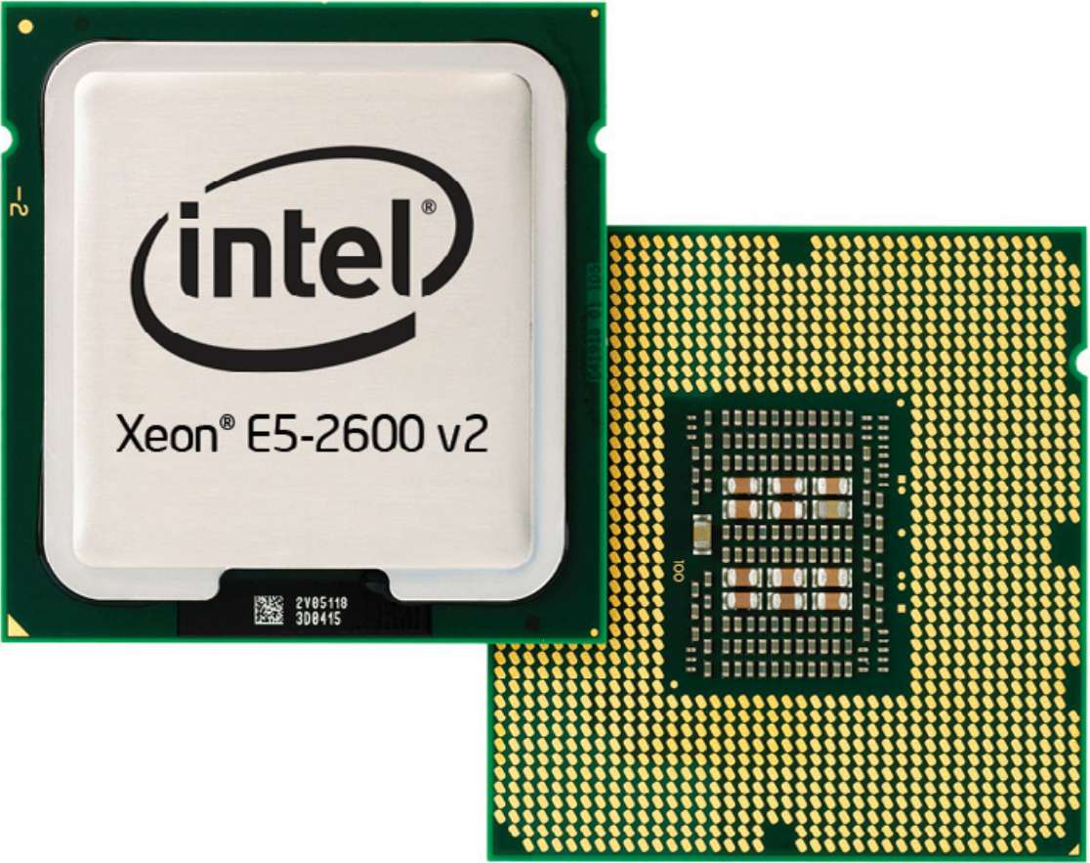
Terminology
node
node1
node
node
node2
node
node3
Hopper
168 nodes
2 sockets x E5-2680 v2
10 cores per CPU
20 cores per node
1 thread per core
3360 cores
3360 threads
node
node4
node
node5
node
node6
Interconnect
(Infiniband)

Slide 6
Levels of parallelism
Several nodes can cooperate on a task
Distributed memory parallellization
Nodes communicate information via interconnect
Typically using MPI: Message Passing Interface
Several cores can cooperate on a task
Shared memory parallellization
Cores communicate information via memory
Often using OpenMP, but also MPI, …

Slide 7
Levels of parallellism
A single core may exploit pipelining and vectorisation to execute instructions in parallel

Slide 8
Pipelining
Instructions break down in micro-instructions
Each micro-instruction uses a distinct part of the hardware
Instruction fetch (IF)
Instruction Decode (ID)
Execution (EX)
Memory Read/Write (MEM)
Result Writeback (WB)
[https://en.wikibooks.org/wiki/Microprocessor_Design/Pipelined_Processors]

Slide 9
Pipelining
5 instructions executing simultaneously

Slide 10
Vectorization
Register 1
A_{i}
A_{j}
A_{k}
A_{l}
Potentially 4x faster
[if the loads and stores can be executed fast enough]
+_{vector}
+
Register 2
B_{i}
B_{j}
B_{k}
B_{l}
=
=_{vector}
Register 3
C_{i}
C_{j}
C_{k}
C_{l}
Load 2 operands in register
Execute 1 add instruction
Store 1 result
Load 2x4 operands in register
Execute 1 vadd instruction
Store 1x4 results
Single Instruction Multiple Data
(SIMD)
Notes:
2

Slide 11
Vectorization
Fused instructions: Fused Multiply-Add executes y = a*x+b (in vector mode) in one cycle
Vector register width on Hopper is 256 bits
8 single precision numbers
4 double precision numbers
Notes:
vec

Slide 12
Levels of parallellism
3 levels of parallellism:
Intra-core: pipelining and SIMD
Multi-core: shared memory
Multi-node: distributed memory
Who does the work?
Compiler
but it appreciates/needs your help
You and the compiler
OpenMP = directives
Relatively simple
You only
MPI
Harder
Covered today
Notes:
T

Slide 13
Case study – Lennard-Jones system
Monte Carlo setting:
compute the energy of configurations
ensemble averages
no (individual) forces, accelerations or velocities
no time integration
Molecular Dynamics setting:
compute the time evolution of a collection of atoms
Individual forces, accelerations, velocities
[time integration]

Slide 14
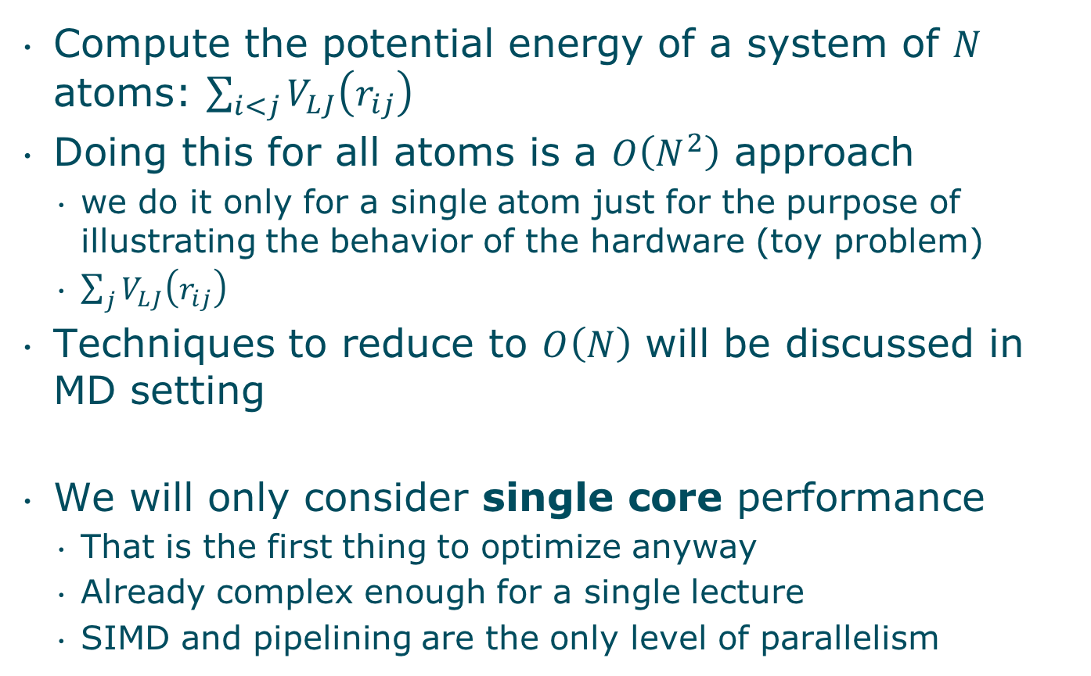
MC experiment
Compute the potential energy of a system of $N$ atoms: $\sum_{i<j}{V_{LJ}\left(r_{ij}\right)}$
Doing this for all atoms is a $O\left(N^{2}\right)$ approach
we do it only for a single atom just for the purpose of illustrating the behavior of the hardware (toy problem)
$\sum_{j}{V_{LJ}\left(r_{ij}\right)}$
Techniques to reduce to $O\left(N\right)$ will be discussed in MD setting
We will only consider single core performance
That is the first thing to optimize anyway
Already complex enough for a single lecture
SIMD and pipelining are the only level of parallelism

Slide 15
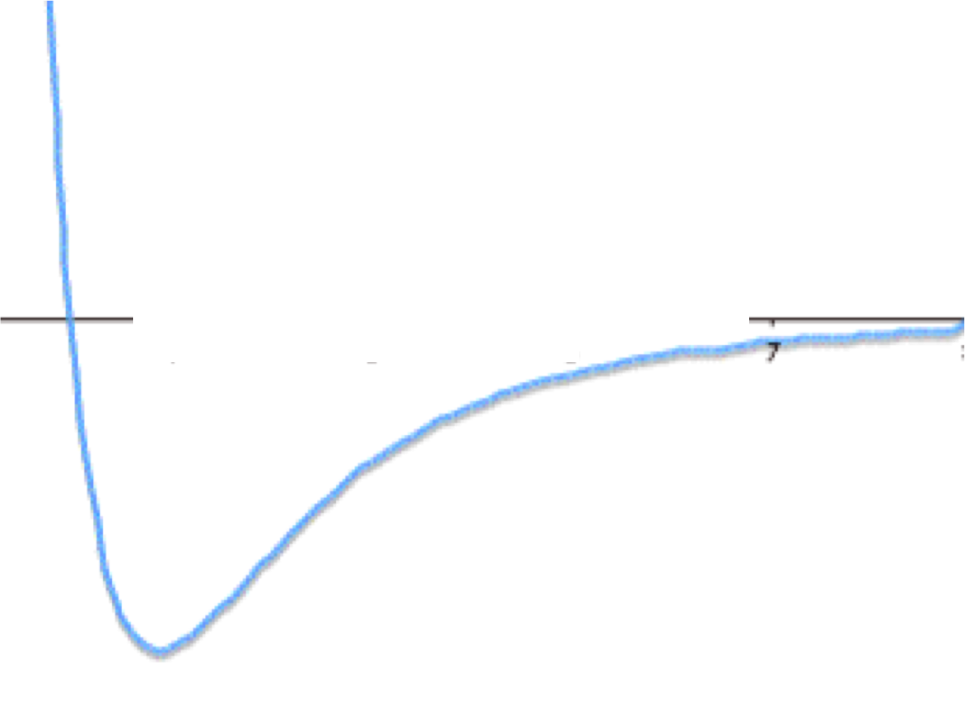
Lennard-Jones interactions
Lennard-Jones potential (neglecting constants)

Slide 16
Lennard-Jones potential (sequential code)
double VLJ0( double r ) {
return 1.0/pow(r,12) - 1.0/pow(r,6);
} // 18.0 x slower
double VLJ1( double r ) {
return std::pow(r,-12) - std::pow(r,-6);
} // 14.9 x slower
double VLJ2( double r ) {
double tmp = std::pow(r,-6);
return tmp*(tmp-1.0);
} // 7.8 x slower
double VLJ3( double r ) {
double tmp = 1.0/(r*r*r*r*r*r);
return tmp*(tmp-1.0);
} // 1.01 x slower
double VLJ( Real_t r ) {
double rr = 1.0/r;
rr *= rr;
double rr6 = rr*rr*rr;
return rr6*(rr6-1);
} // 1 x slower

Slide 17
Lennard-Jones potential
double VLJ( Real_t r ) {
double rr = 1./r;
rr *= rr;
double rr6 = rr*rr*rr;
return rr6*(rr6-1);
} // 1 x slower
double VLJ( Real_t r2 ) {
double rr = 1./r2;
// rr *= rr;
double rr6 = rr*rr*rr;
return rr6*(rr6-1);
} // avoid one sqrt per function call (to compute the distance r)
Notes:
22

Slide 18
Cost of instructions
cheap instructions +,-,* ~1 cycle
Rather expensive / ~10-20 cycles
Expensive sqrt ~35 cycles
Very expensive trigonometric/ logarithmic/ exponential functions ~100-200 cycles
Things get better if pipelining can be exploited
Relative cost remains

Slide 19
MC experiment
x0, y0, z0 : coordinates of our central atom
x1[1:m], y1[1:m], z1[1:m] : coordinates of m neighbouring atoms
Let m=512, 1012, …, 2²⁹~0.5*10⁹
surround by outer loop iterating 2²⁹/m times
every m-case executes 2²⁹ evaluations of V_{LJ}(r²)
Variations
Loop over all m neighbouring atoms contiguously
Structure of arrays (SoA) : x x x ... y y y ... z z z ...
Array of structures (AoS) : x y z ... x y z ... x y z ...
Pick atoms in the arrays x1, y1, z1 with a random permutation

Slide 20
MC - Contiguous - SoA
integer :: m ! # of neighbour atoms
integer :: k ! # of iterations, m*k=cst, same amount of work per iteration
real(wp) :: x0,y0,z0, p(3*m)
! Contiguous access, SoA: p=[xxx…yyy…zzz…]
do ik=1,k
do im=1,m
r2 = (p(im)-x0)**2 +(p(m+im)-y0)**2 +(p(2*m+im)-z0)**2
v = v + lj_pot2(r2)
enddo
enddo
1 | x |  |  |  |  | y |  |  |  |  | z
2 |  | x |  |  |  |  | y |  |  |  |  | z
3 |  |  | x |  |  |  |  | y |  |  |  |  | z

Slide 21
MC - Contiguous - AoS
integer :: m ! Number of neighbour atoms
real(wp) :: x0,y0,z0, p(3*m)
! ordered access, AoS: p=[xyzxyzxyz…]
do ik=1,k
do im=1,m
r2 = (p(im)-x0)**2 +(p(1+im)-y0)**2 +(p(2+im)-z0)**2
v = v + lj_pot2(r2)
enddo
enddo
1 | x | y | z
2 |  |  |  | x | y | z
3 |  |  |  |  |  |  | x | y | z

Slide 22
MC - Random access
integer :: m ! Number of neighbour atoms
real(wp) :: x0,y0,z0, p(3*m)
integer :: j(m) ! random permutation of [1:m]
! random access
do ik=1,k
do im=1,m
r2 = (p(j(im))-x0)**2 +(p(j(im)+m)-y0)**2 +(p(j(im)+2*m)-z0)**2
v = v + lj_pot2(r2)
enddo
enddo
1 |  |  | x |  |  |  |  | y |  |  |  |  | z
2 |  | x |  |  |  |  | y |  |  |  |  | z
3 |  |  |  |  | x |  |  |  |  | y |  |  |  |  | z

Slide 23
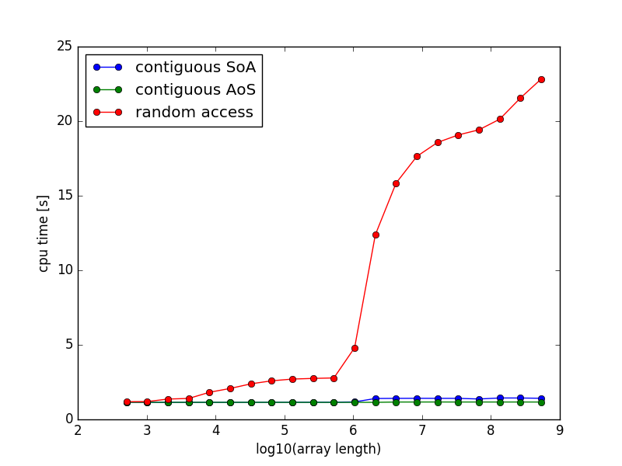
Results
Q1: What is going on?
Q2: is this the best we can get?

Slide 24
Performance
Which factors influence performance of a code?
Machine limits

Slide 25
Peak performance
≝ Maximum # floating point operations per second
For a single core the peak performance =
2*8 instructions per cycle in SP
2*4 instructions per cycle in DP
The 2 comes from the fused multiply and add
The 8, resp. 4 come from the vector register width
Peak performance per node
(1 cycle = 1/clock_frequency)
Assuming 1 hardware thread per core:
(#cores=20) * 2*8(SP) * (f=2.8Ghz) = 896 Gflop/s
(#cores=20) * 2*4(DP) * (f=2.8Ghz) = 448 Gflop/s
Notes:
vec

Slide 26
Performance
Peak performance is not the only limiting factor…
It is not the most common limiting factor
Instructions operate on data, ...
Data resides in memory
Accessing data takes time (and energy)
Data has to be moved from memory to cpu register before it can be processed
Peak performance has increased much faster than the speed at which data can be moved between memory and cpu

Slide 27
Speed of moving data
Memory bandwidth
The maximum number of bytes that can be moved per second between main memory and the cores
Hopper
92-110 GB/s (varies depending on read:write ratio)
Memory latency
The number of cycles (or the time) needed to fetch a single item from main memory
Hopper
~180 cycles (within socket)
~350 cycles (across sockets)

Slide 28
Performance
Code is compute bound if
The cpu can execute its compute instructions without having to wait for data
The limit is the theoretical peak performance
[Used to be the common case – not any more]
Code is memory bound if
A considerable amount of cycles is spent waiting for data
Too much data requested:
Bandwidth saturation = machine limit
Too distant data requested:
If data is not in the cache: latency penalty
Latency problem = machine limit
[most common situation]

Slide 29

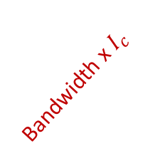
Roofline model
Useful video: https://software.intel.com/en-us/videos/roofline-analysis-in-intel-advisor-2017
Bandwidth saturated
Running below peak performance
Not energy efficient
Sweet spot:
All resources optimally used:
Bandwidth saturated
Running at peak performance
Running at peak performance Bandwidth not saturated Energy efficient computation
(Moving data costs more energy than executing instructions)
Memory bound
Compute bound
peak performance
Bandwidth x$I_{c}$
Performance = flops per second
Running below all machine limits
Mixture of compute bound and memory bound sections
Cache misses
Expensive instructions
Memory bound = most common situation
Computational intensity $I_{c}$ = flops per Byte
Notes:
*

Slide 30
Memory bound - consequences
Optimizing code was about organizing compute instructions
Pretty straightforward: less compute cycles is less cputime
Algorithmic complexity was important guideline
Optimizing code is optimizing data access
To keep the processor busy doing useful stuff
Algorithmic complexity is no longer a guarantee for optimal performance
E.g. linear search (as in a map) often faster than binary or other search algorithms, also sorting
For large N low order complexity wins, but hardware caching takes an early lead
Understanding how memory works is necessary
Experimenting and measuring is necessary

Slide 31
Hierarchical memory organisation
ALU
memory
size speed
Registers: ~1kB per core 0 cycles
On-chip (E5-2680 v2)
L1 Cache: 32 kB per core ~1 cycles
L2 Cache: 256 kB per core ~10 cycles
L3 Cache: 25 MB per socket ~50 cycles
DRAM: 64-256 GB per node ~200 cycles
Off-chip

Slide 32
Memory organisation
Memory is not fetched on a per item basis
But in chunks called cache lines
typically 64 Bytes long
16 single precision items
8 double precision items

Slide 33
Memory organisation
Linear search of array A[i], i=1..n
A[1] is not in cache, wait time before cache line is loaded, dram latency (~200 cycles) and before item A[1] can be examined
Once the cache line is loaded, A[2..16] are also in L1 cache and are ready to be examined without delay
Hardware recognizes your loop over the array and keeps loading next (or previous) cache lines into the L1 cache, so that the delay is vanishing
Depending on how much work it takes to examine each item, as soon as item A[16], the next cache line A[17:32] may have been loaded already or not
In any case, the wait time is now less than the dram latency (~200 cycles)
The limitation becomes memory bandwidth of the machine

Slide 34
Memory organisation
Binary search of array A[i], i=1..n
A[n/2] is not in cache, wait time before cache line is loaded, dram latency
Next item needed is A[n/4] or A[3n/4], which is not in the cache, dram latency hits you again
In fact, the dram latency keeps on hitting you until the search range is reduced to one or two cache lines,
You do only one examination/dram latency, as opposed to 16/dram latency in linear search.

Slide 35
Memory organization
Instructions are also data stored in memory
Branching instructions can cause cache misses too!
Instruction cache misses
Avoid unpredictable branches in loops

Slide 36
Need more insight?
code::dive conference 2014 - Scott Meyers: Cpu Caches and Why You Care
https://www.youtube.com/watch?v=WDIkqP4JbkE

Slide 37
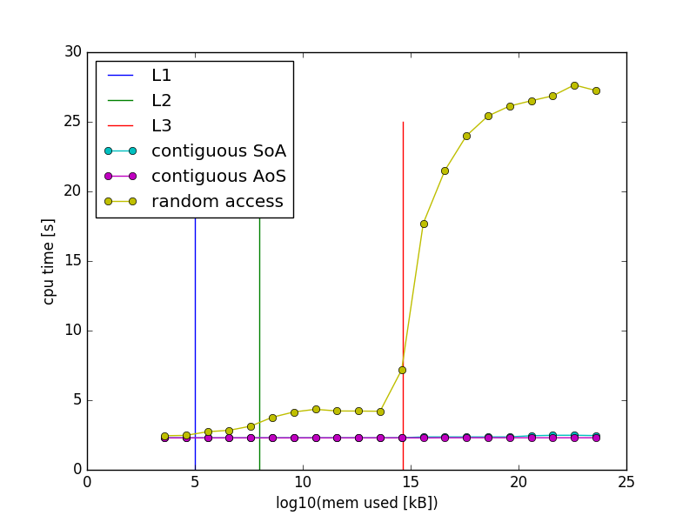
Experiment
Cache boundaries
Q1: What is going on?
15x slower
Mem used = 3*m*8 Bytes

Slide 38
Experiment
Q2: is this the best we can get?

Slide 39
Flops per second
3-, 2+, 3*
1/
2*
2*, 1-
--------------
14 flops
! Contiguous access, SoA: p=[xxx…yyy…zzz…]
do ik=1,k
do im=1,m
r2 = (p(im)-x0)**2
+(p(m+im)-y0)**2
+(p(2*m+im)-z0)**2
! r = lj_pot2(r)
r2i = 1.0d0/r2
rr6i = r2i*r2i*r2i;
lj_pot2 = 4.0d0*rr6*(rr6-1.0d0);
enddo
enddo
14 flops * 2²⁹ iterations in 1.2 s = 6.26 10⁹ flops/s
peak performance: 1*1*4*2.8 GHz = 11.2 Gcycles/s = 11.2 Gflops/s
We are running at 55.9 % of peak performance

Slide 40
Experiment
Q2: is this the best we can get?
Not really, there is 44% room for improvement
Q3: why aren’t we running faster

Slide 41
Bytes per second
3-, 2+, 3*
1/
2*
2*, 1-
------------
14 flops
3 DP
----------
24 B
! Contiguous access, SoA: p=[xxx…yyy…zzz…]
do ik=1,k
do im=1,m
r2 = (p(im)-x0)**2
+(p(m+im)-y0)**2
+(p(2*m+im)-z0)**2
! r = lj_pot2(r)
r2i = 1.0d0/r2
rr6i = r2i*r2i*r2i;
lj_pot2 = 4.0d0*rr6*(rr6-1.0d0);
enddo
enddo
24 B *2²⁹ iterations in 1.2 s = 10.7 GB/s
Bandwidth measured by Intel mlc:
109 GB/s for 10 threads (all reads)
10.9 GB/s for 1 thread
We are running at maximal bandwidth
Bandwidth saturation

Slide 42
Experiment
Q2: is this the best we can get?
Yes and No
No: We are processing the maximum amount of data in the time given (but the processor is idle for 44% of the time).
Yes: We can improve if we can do more useful work on the data while they are in cache.

Slide 43
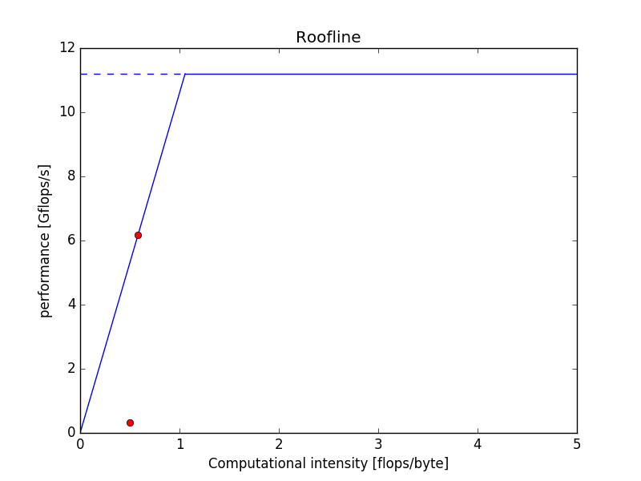
Roofline model
Roofline for a 1 core job on a hopper node
Peak performance
11.2 Gflops/s
Can we improve?
On first sight: bandwidth saturated
Thinking again:
We can do more useful work with the data while they’re in cache =
increase the computational intensity
E.g. implement something more accurate than Lennard-Jones
Slope = bandwidth = 10 GB/s
Ordered data access
MEMORY BOUND!
56% of peak performance
Can we improve?
First: improve data access pattern to reduce the cache misses
Then: if bandwidth saturates increase the computational intensity
Random data access
Dominated by cache misses
3% of peak performance

Slide 44
For simple cases
a back of the envelope calculation like this
and an understanding of how memory works
can guide you to more efficient code
For real cases we need something more sophisticated
Notes:
Studio x

Slide 45
Intel Parallel Cluster xe
Intel Advisor xe
Vectorization and threading
Intel VTune Analyzer xe
Data access and cpu utilization
Intel Inspector
Thread performance analysis (OpenMP, Intel TBB)
Intel Cluster Inspector
MPI process performance analysis
For a later session
Notes:
C

Slide 46
Intel advisor
https://software.intel.com/en-us/get-started-with-advisor
https://software.intel.com/en-us/get-started-with-vtune

Slide 47
Intel Advisor
$ssh –X vsc20170@login.hpc.uantwerpen.be
Last login: Thu Sep 8 16:38:25 2016 from 143.169.185.55
-----------------------------------------------------------
Welcome to Hopper!
...
vsc20170@ln02 ~$
vsc20170@ln02 ~$ qsub –I –X
vsc20170@r5c6cn05 ~$
vsc20170@r5c6cn05 ~$ module load Advisor
vsc20170@r5c6cn05 ~$ module list
Currently Loaded Modulefiles:
1) Advisor/2016_update4
vsc20170@r5c6cn05 ~$
vsc20170@r5c6cn05 ~$ advixe-gui &
Allow X11 forwarding. On macOS install XQuartz, On Windows install Xming
Start interactive job with X11 forwarding.
The compute node we are running on
& = Run in background, so the
terminal remains functional

Slide 48
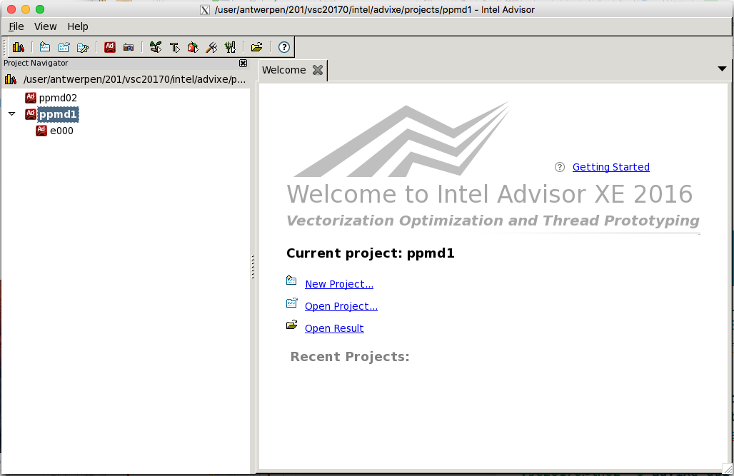
Intel Advisor

Slide 49
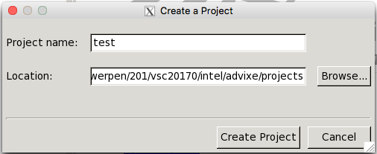
Intel Advisor

Slide 50
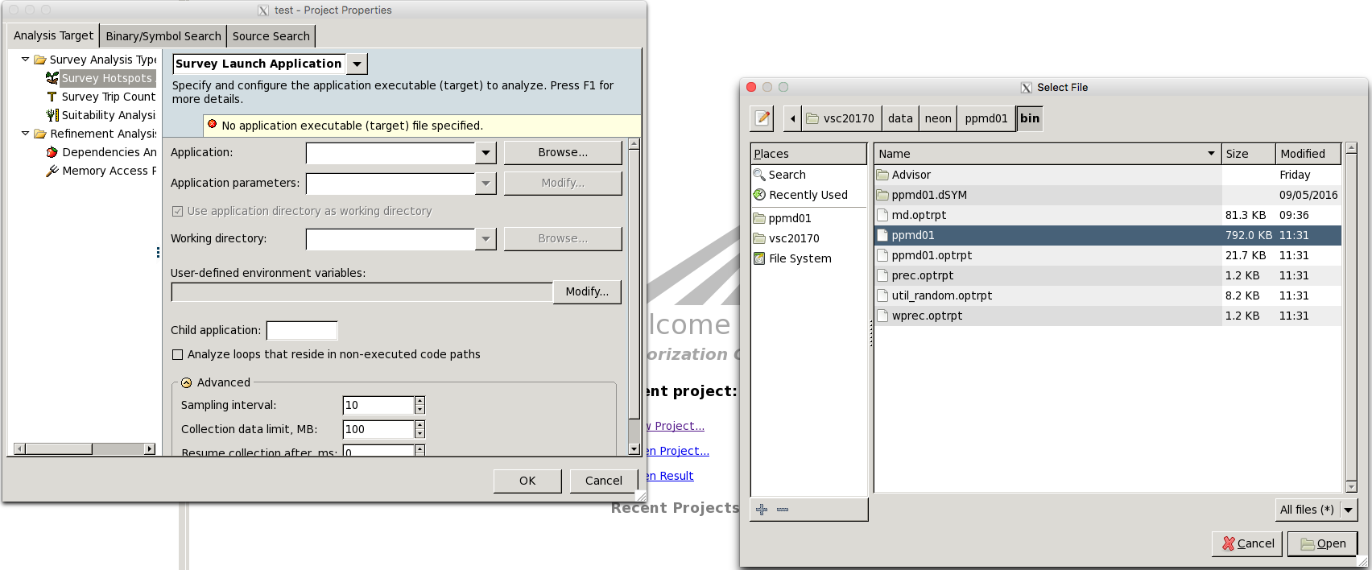
Intel Advisor

Slide 51
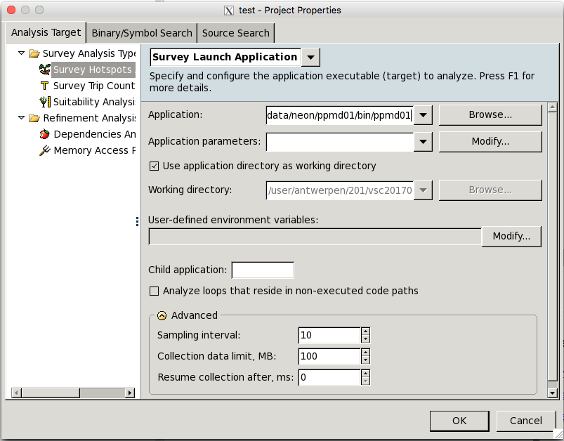
Intel Advisor

Slide 52
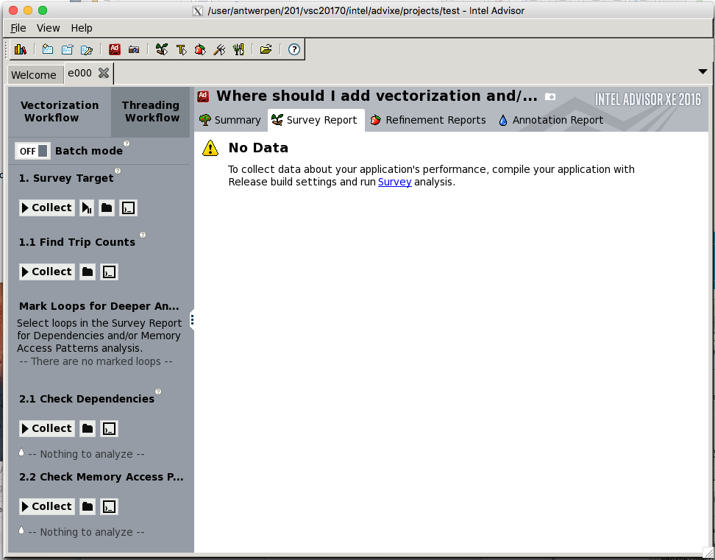
Intel Advisor

Slide 53
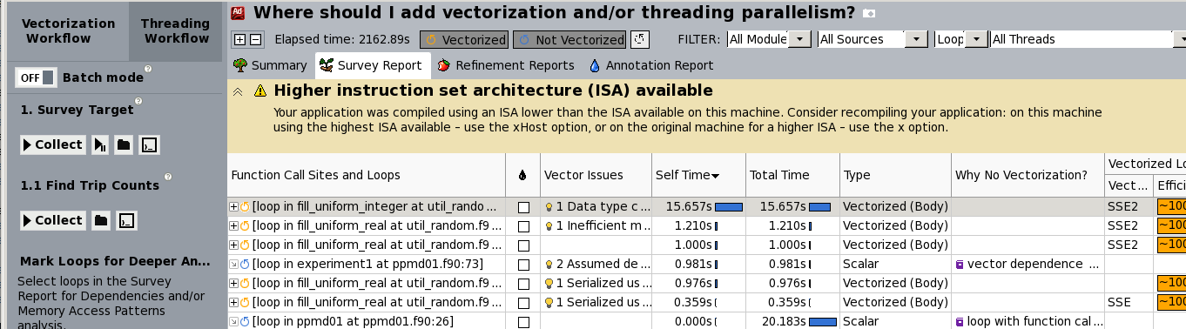
Intel Advisor
Add compiler option –xHost

Slide 54
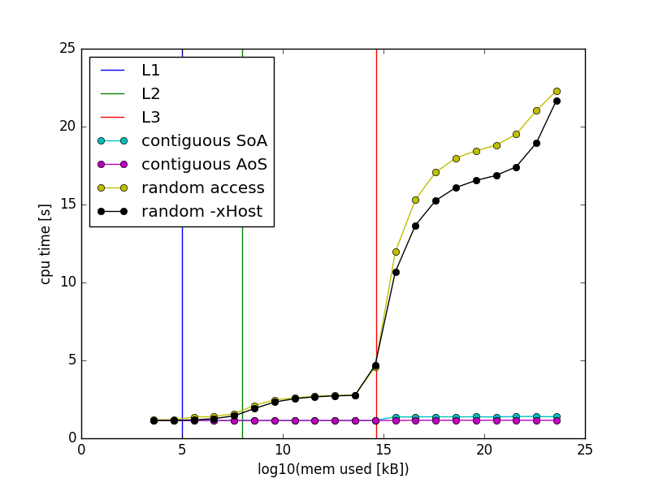
Intel Advisor
Slight improvement
But not what we hoped for

Slide 55
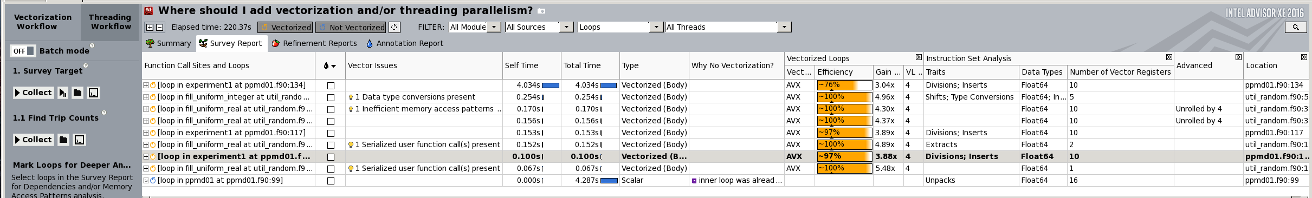
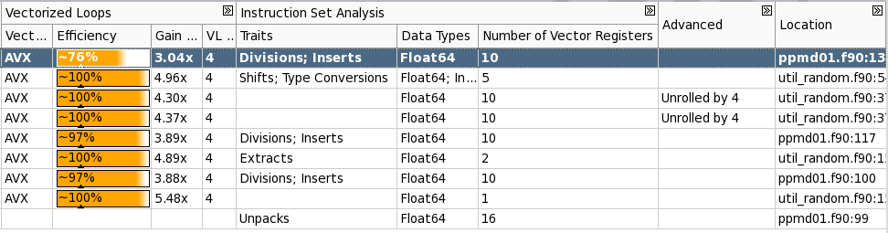
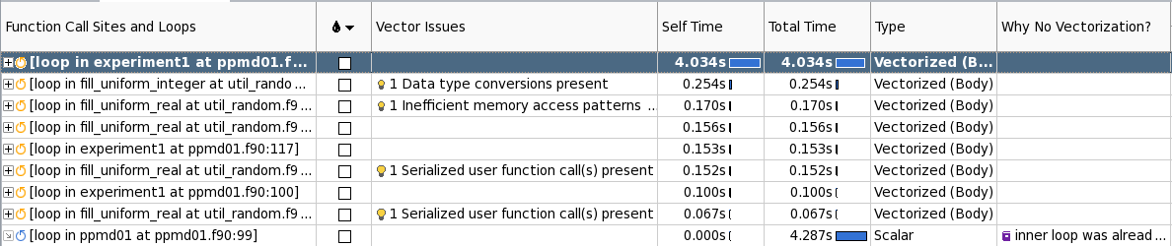

Intel Advisor
Run Intel Advisor again
List of hot spots
Random access
Contiguous-AoS
Contiguous-SoA
Loop over m

Slide 56
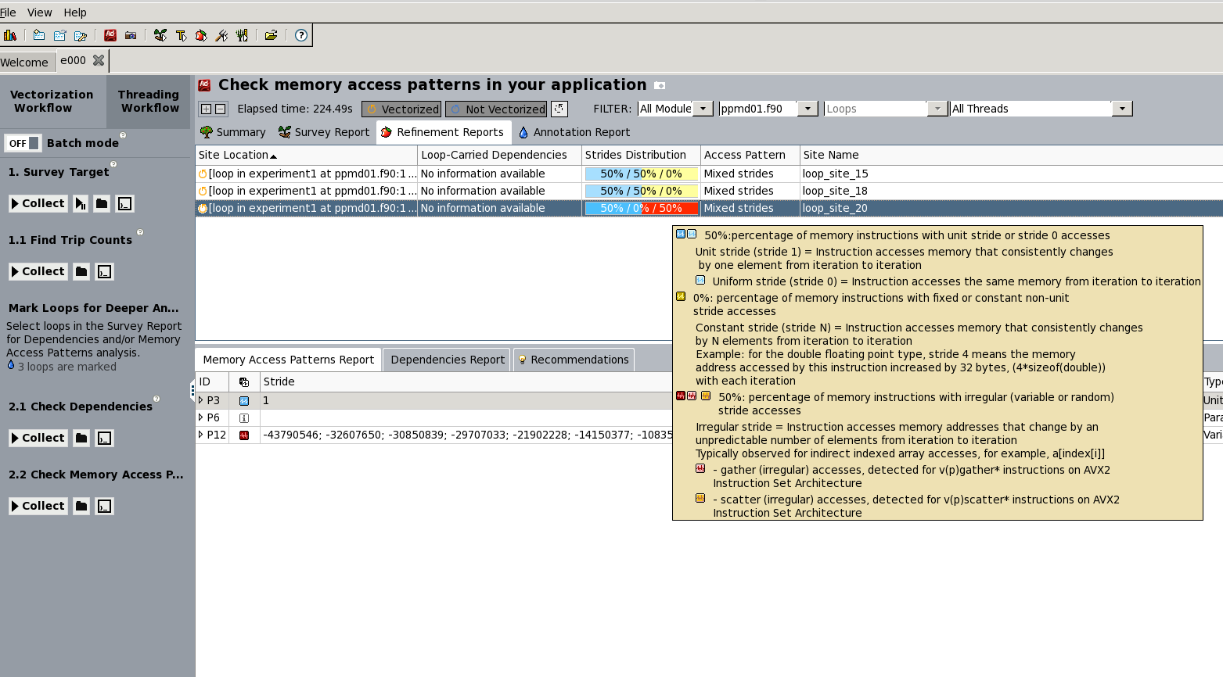
Intel Advisor

Slide 57
Advisor tells us
Vectorization is ok
Strided memory access in the random access loop is a problem
Let’s run a memory access analysis in VTune

Slide 58
Intel Vtune Amplifier
$ssh –X vsc20170@login.hpc.uantwerpen.be
Last login: Thu Sep 8 16:38:25 2016 from 143.169.185.55
-----------------------------------------------------------
Welcome to Hopper!
...
vsc20170@ln02 ~$ module load VTune
vsc20170@ln02 ~$ module list
Currently Loaded Modulefiles:
1) GCCcore/5.4.0 4) ifort/2016.3.210-GCC-5.4.0-2.26 7) VTune/2016_update3
2) binutils/2.26-GCCcore-5.4.0 5) iccifort/2016.3.210-GCC-5.4.0-2.26
3) icc/2016.3.210-GCC-5.4.0-2.26 6) Advisor/2016_update4
vsc20170@ln02 ~$
vsc20170@ln02 ~$ amplxe-gui &

Slide 59
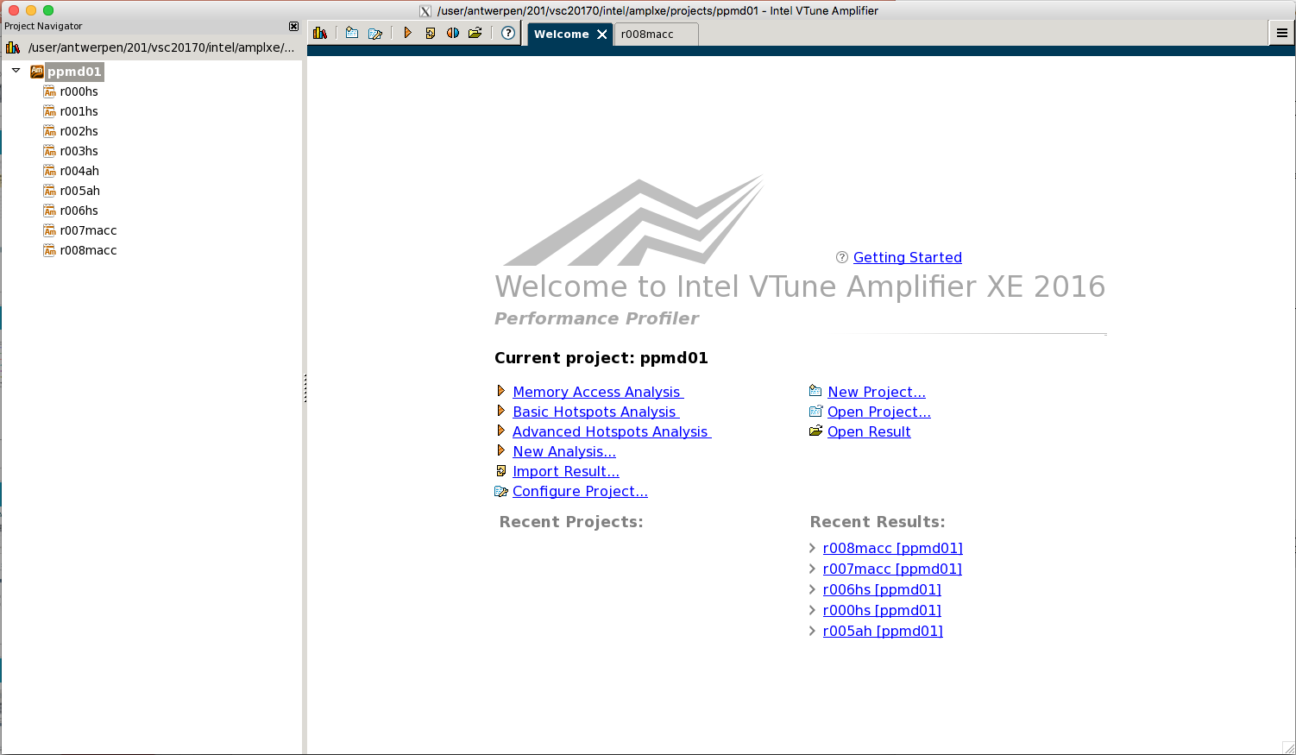
Intel Vtune Amplifier
Some Hot Spot analyses
Some Hot Spot analyses
Some Hot Spot analyses
Some Hot Spot analyses
Some Hot Spot analyses
Some Advanced Hot spot analyses
Some Advanced Hot spot analyses
Some Memory ACCess analyses
Some Memory ACCess analyses

Slide 60
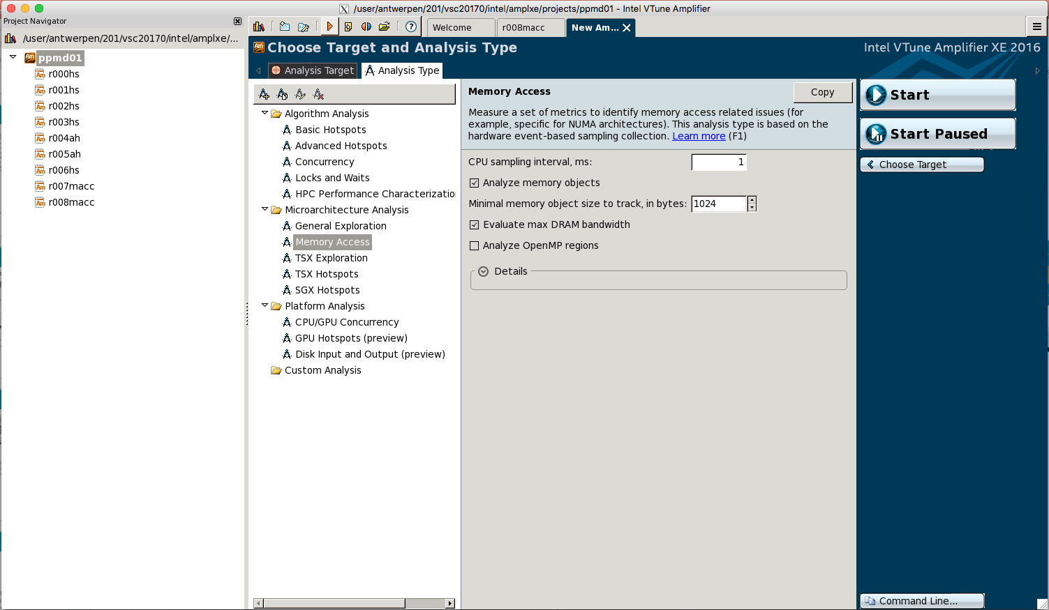
Intel Vtune Amplifier
New analysis
Hit start
Analyze memory access

Slide 61
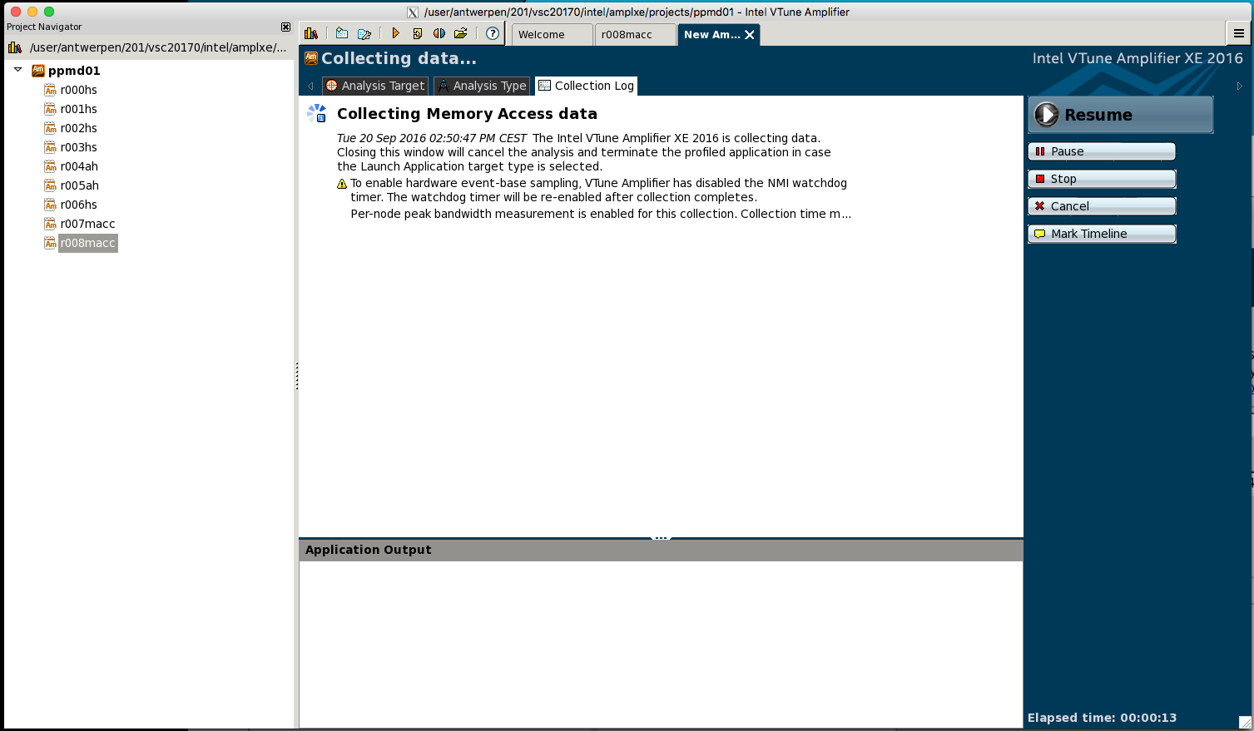
Intel Vtune Amplifier

Slide 62
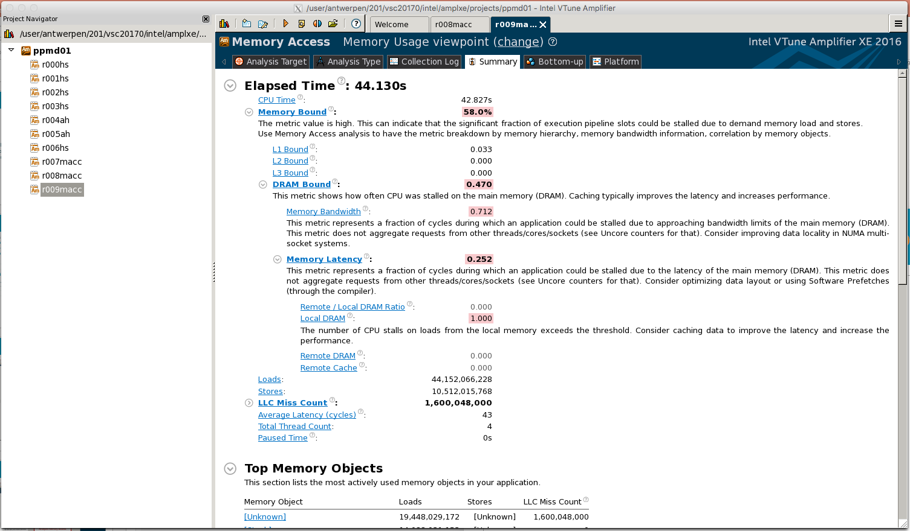
Intel Vtune Amplifier
Our program is memory bound
Due to complete cache misses
Bandwidth saturates fast because we move an entire cache line for almost every data item
# complete cache misses
Average # of cycles we have to wait for a data item (should be ~1!)

Slide 63
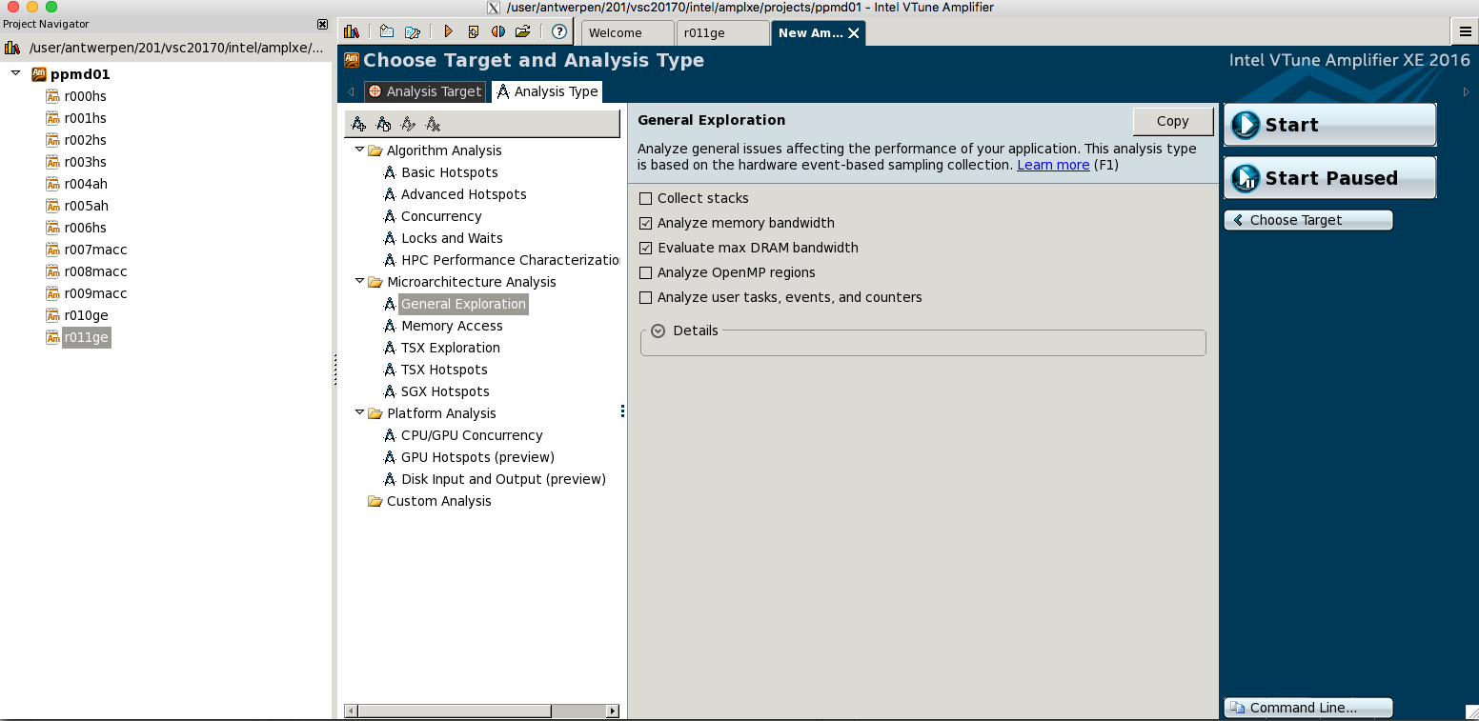
Intel Vtune Amplifier

Slide 64
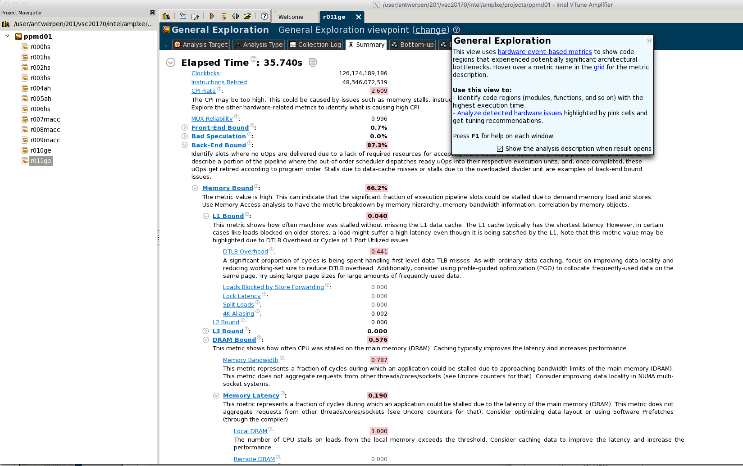
Intel Vtune Amplifier

Slide 65
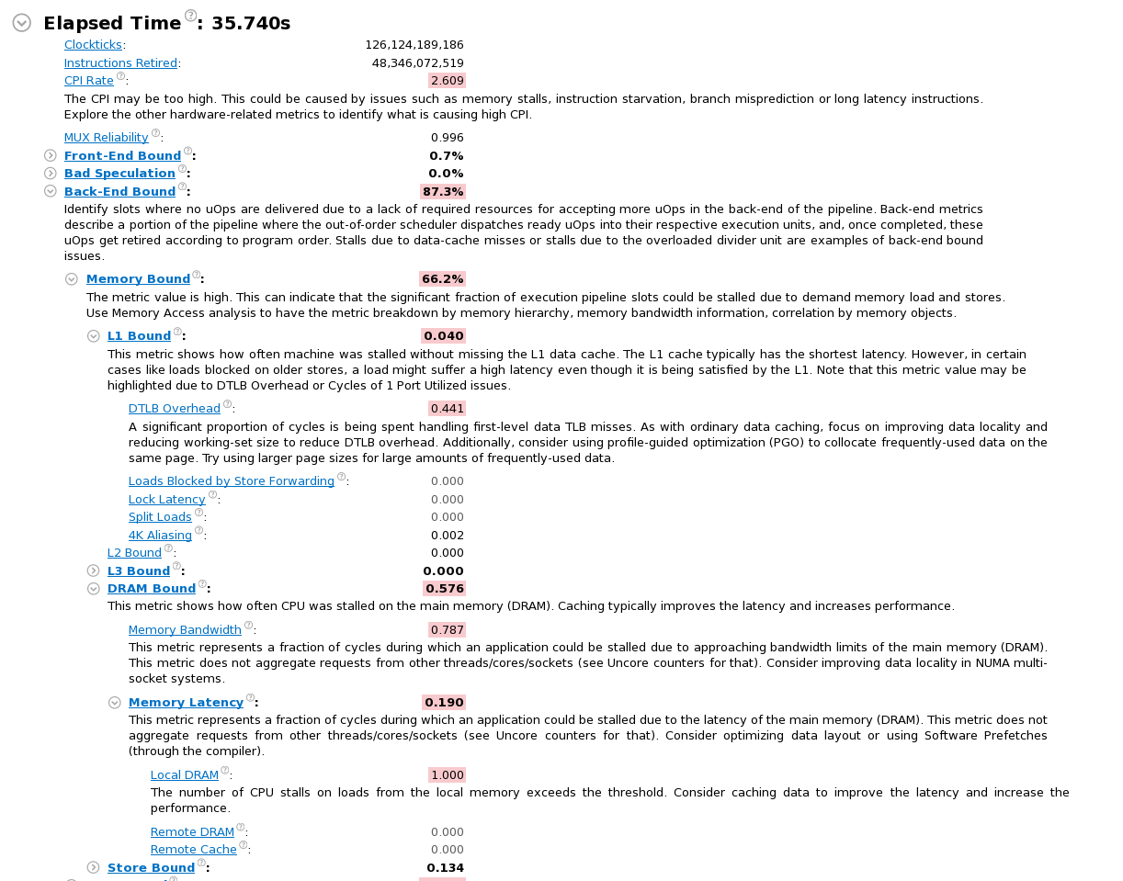
Intel Vtune Amplifier
CPI = cycles per instruction
Peak performance corresponds to 4 instructions per cycle in DP vectorized code. Hence CPI should be between 0.25 and 0.5.
Pipeline stalls (because the data is not arriving in time)
Our program is memory bound
Our program is memory bound
Bandwidth saturates fast because we move an entire cache line for almost every data item

Slide 66
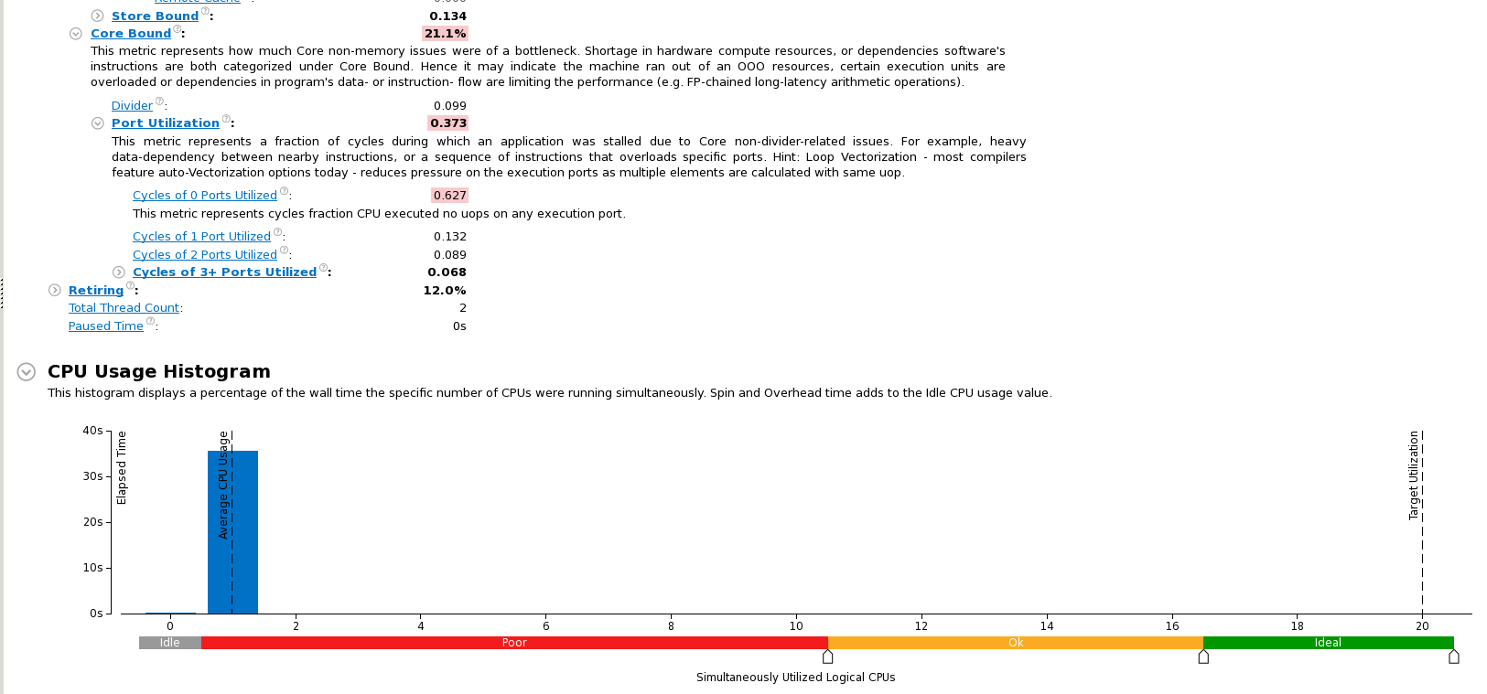
Intel Vtune Amplifier
Only one of 20 cores were use (no OpenMP paralellization)

Slide 67
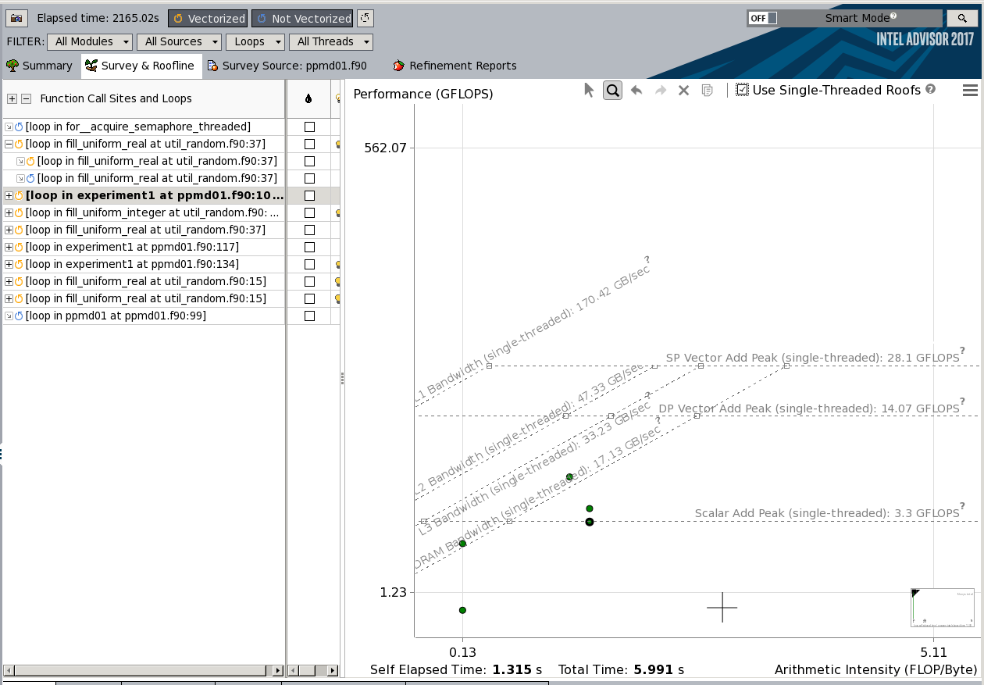
New in Intel cluster studio 2017 automatic roofline model
Contiguous-AoS
Contiguous-SoA
Random access

Slide 68
Roofline model
Does my application work optimally on the current hardware?
What limits the performance of my code?
Is my application workload memory or compute bound?
What is the right strategy to improve the performance of my code?
Extremely useful to know when to stop optimizing and when to continue …

Slide 69
Advisor vs Vtune amplifier
Advisor is profiler
Analyzes your code on a per statement basis
Looks at the assembly code to analyze vectorization
Hints to the location of the problem
Vtune Amplifier accumulates statistics on hardware events such as expensive instructions, vector instructions, cache misses, …
Statistics accumulated on a per subprogram (function, subroutine) basis, not per statement
Hints to the nature of the problem
Both are complementary

Slide 70
What have we learned so far
Compiler does good job at producing vectorized code
Advisor will tell you if and why the compiler is sometimes not able to produce vectorized code, and will suggest solutions
Advisor tells you which parts of your code consume the most cputime and are candidates for optimization

Slide 71
What have we learned so far
Most often performance problems on modern cpus are due to memory access problems (DRAM latency hits you)
VTune amplifier gives you clues on how and where to fixes the issues
CPI and Cache Misses
Optimize
If there are cache misses, try to reduce them
Easier said than done (we’ll come to that in the next section)
If you are memory bound and CPI is high,
Verify vectorization
Increase the computational complexity (do more useful work on the data while it is in cache)

Slide 72
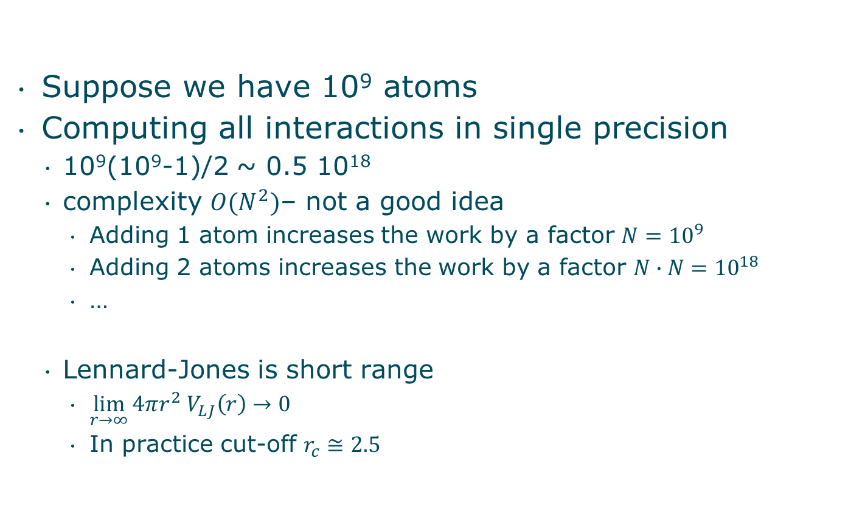
Molecular dynamics settings
Suppose we have 10⁹ atoms
Computing all interactions in single precision
10⁹(10⁹-1)/2 ~ 0.5 10¹⁸
complexity $O(N^{2})$– not a good idea
Adding 1 atom increases the work by a factor $N={10}^{9}$
Adding 2 atoms increases the work by a factor $N∙N={10}^{18}$
…
Lennard-Jones is short range
$\lim_{r→∞}{4πr^{2} V_{LJ}\left(r\right)}→0$
In practice cut-off $r_{c}≅2.5$

Slide 73
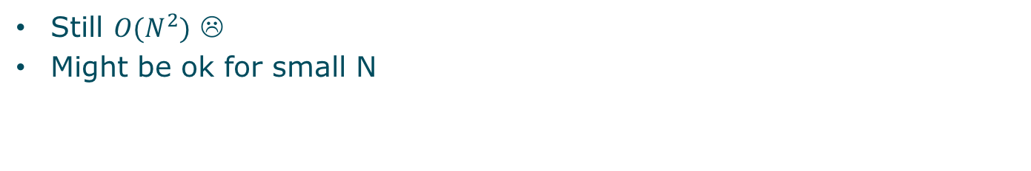
Implementing cut-off
forces = 0
do i=1,N
do j=1,N-1
r2 = squared_distance(i,j)
if r2<rcutoff2
force_ij = ljforce(r2)
force(i) = force(i) + force_ij
force(j) = force(j) - force_ij
endif
enddo
enddo
integrate forces to update atom positions
Still $O(N^{2})$ ☹
Might be ok for small N

Slide 74
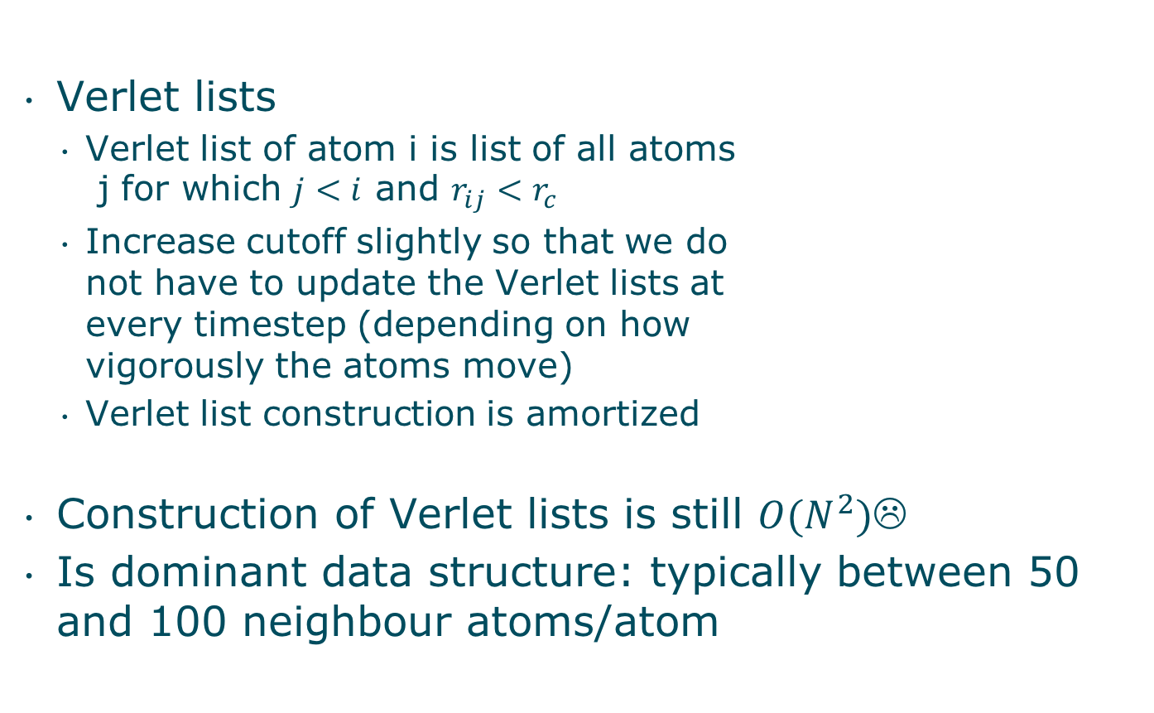
Implementing cut-off
Verlet lists
Verlet list of atom i is list of all atoms j for which $j<i$ and $r_{ij}<r_{c}$
Increase cutoff slightly so that we do not have to update the Verlet lists at every timestep (depending on how vigorously the atoms move)
Verlet list construction is amortized
Construction of Verlet lists is still $O(N^{2})$☹
Is dominant data structure: typically between 50 and 100 neighbour atoms/atom

Slide 75
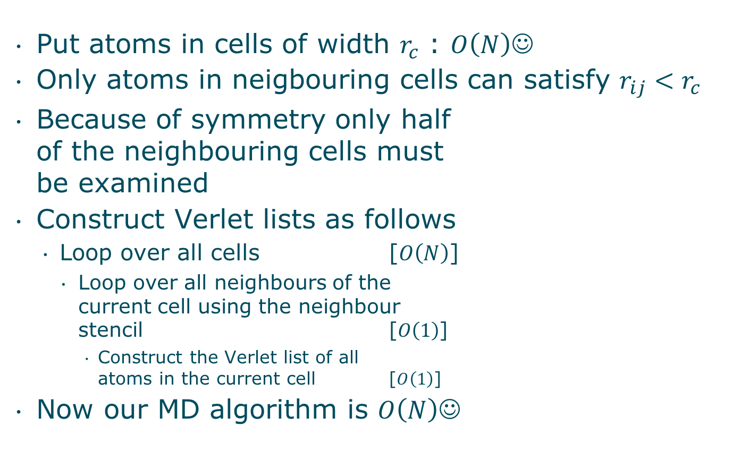
Implementing cut-off
Put atoms in cells of width $r_{c}$ : $O\left(N\right)☺$
Only atoms in neigbouring cells can satisfy $r_{ij}<r_{c}$
Because of symmetry only half of the neighbouring cells must be examined
Construct Verlet lists as follows
Loop over all cells [$O\left(N\right)$]
Loop over all neighbours of the current cell using the neighbour stencil [$O\left(1\right)$]
Construct the Verlet list of all atoms in the current cell [$O\left(1\right)$]
Now our MD algorithm is $O\left(N\right)☺$

Slide 76
Implementing cut-off
Atoms move!
Iterating over the Verlet lists to compute the interactions will soon jump randomly through memory
Performance evolves naturally to the random access case
Fix data access pattern using spatial sorting
Spatial sort = ensure that atoms which are close in space are also close in memory
This reduces cache misses

Slide 77
Fixing the data access pattern
Space filling curve
Linearize a space of dimension >1
Hilbert curve
Hilbert index: coordinate of a cell along the Hilbert curve
Locality guarantee: points close in space are also close along the space filling curve (on average)
2
3
6
7
10
11
5
8
9
12
1
4
4
3
14
13
1
2
15
16

Slide 78
Fixing the data access pattern
Sort atom property arrays (rx,ry,rz,vx,vy,vz,…) based on the Hilbert index h of the cell of the atoms (spatial sort).
Atoms which are close in space (and hence will interact) will be close in memory (and hence will be in the cache with high probability)
Build a table containing the index of the first atom in each cell, and the number of atoms in the cell (Hilbert list)
Build Verlet list from the Hilbert list (discard the latter)
Compute the interactions by looping over the Verlet list
Integrate forces, updating velocities and positions and time
If need_to_rebuild_verlet_list is true jump back to step 1. else continue at step 4.

Slide 79
Fixing the data access pattern
We need to
Compute Hilbert indices
Sort atom property arrays
Build Hilbert list and Verlet list
Fixing data access patterns can be a lot of work

Slide 80
Intermezzo Choosing a programming language
Implementation in Fortran? C? C++?
Arguments
C++ is inefficient
Modern compilers good enough to generate efficient code
After all your are using the same hardware
Fortran is efficient
Also fortran has constructs that sometimes come in handy, but can kill performance
But C++ has quite a bit more features which can kill performance than Fortran
Because C++ is a general purpose language and Fortran is meant for scientific computing
Yet these features can be extremely useful if you use them wisely
For computational kernels where performance is an issue you generally need to stay close to the C subset and far away from the C++ features such as classes, inheritance, virtual functions, etc. (templates are an exception)
Lie #1
Lie #2

Slide 81
Intermezzo Choosing a programming language
I’ll use C++ because I know it better
Unless you have read and understood all the C++ books by Scott Meyers, Herb Sutter, Andrei Alexandrescu, Nicolai Josuttis
In which case you probably also understand which C++ features can kill performance and when they should be used to your advantage
For number-crunching I find myself advancing faster using Fortran than using C++ (which I do know better!)
Most often a lie too!

Slide 82
Intermezzo Choosing a programming language
I’ll use C++ because it is better documented
There aren’t too many books on Fortran like the above ones on C++
There is no website of the same quality as cplusplus.com or cppreference.com for Fortran (imho)
But still it is much harder to learn and to learn to use efficiently
Not a valid argument
Not a lie

Slide 83
Intermezzo Choosing a programming language
I’ll use C because that is the language in which Python was written and I want too integrate my code with Python
Python integration leverages your code with
A high level programming interface:
Providing initial data for your simulation is much easier and flexible through a Python script than having to parse input files…
Compose and customize high level solution schemes with ease (e.g. choosing another solver for a subproblem)
Hundreds of very useful open source Python libraries: Numpy, Scipy, Pandas, matplotlib, …
But …
Good point!

Slide 84
Intermezzo Choosing a programming language
I’ll use C because that is the language in which Python was written and I want too integrate my code with Python [continued]
…
But the easiest way to create your own module that can be imported in Python is through f2py
Automatically turns your Fortran code into a Python module
As simple as
F2py –c mysource.f90 –m myPythonModule
Automatically integrates with Numpy! Pass Numpy arrays to your own Fortran library with no effort and no copying of data!
Much harder in C
Also feasible in C++ with the help of boost.python and boost.multi_array, easier than C but not as easy as f2py
∴ stick to Fortran

Slide 85
Intermezzo Choosing a programming language
I’ll use C/C++ because I don’t want to mess with storage orders
Fortran uses column-major ordering indices start at 1
C/C++ use row-major ordering indices start at 0
Plenty of ways to mess up!
Inadvertent copying of the array when passing to fortran!
Trivial for 1D arrays (but mind the indexing)
Numpy arrays by default use the C convention, but arrays can be easily made to follow the Fortran convention:
A=numpy.empty( (2,2), dtype=np.float32, order=‘F’)
A little bit of experimentation will take away the confusion
Simplest way to avoid problems:
If you use fortran modules adhere to fortran convention in numpy arrays
If you use C/C++ modules adhere to C/C++ convention in numpy arrays
If you use both pay attention..
Good point!

Slide 86
Intermezzo Choosing a programming language
I’ll use X because I need to use some library Y that is written in X
Point taken, often the easiest way
Valid argument for libraries that deal with parallelization issues:
TBB, for shared memory parallelization (C++)
Libraries abstracting vector instructions Vc, boost.simd (C++)
However, there is a lot of support for mixed language programming
If you do not master X you might end up writing inefficient code and loosing the advantage of using Y
it may be worthwhile to find out how to tackle the mixed language challenge
Once done, you will proceed faster and write efficient code

Slide 87
To conclude
Stick to Fortran
(unless you are a seasoned C++ programmer)
Using Python and Numpy for high level programming and Fortran (C++) for your own number-crunching routines is a very practical approach
Use f2py to turn your fortran routines into a Python module that is compatible with Numpy

Slide 88
Intermezzo Choosing a programming language
Details of Python+Numpy+Fortran/C++ is topic of another talk
Including shared memory parallelism (multi-threading) and distributed memory parallelism (multi-node)

Slide 89
Recent alternative
Julia : http://julialang.org
Inspired by the best features of all programming languages

Slide 90
Back to Lennard-Jones MD
Organizing the computations
Python
Initialization, construct Verlet lists, control experiment, testing, …
Store atom data in Numpy arrays
Python module
“import pyMDFortran”
Python module
“import pyHilbertCpp”
f2py (Numpy)
C++, boost.python, boost.multi_array
Computational kernel Fortran
MD stuff
LJ potential, force, loop over verlet list
Hilbert curve
C++
[i,j,k] <-> h

Slide 91
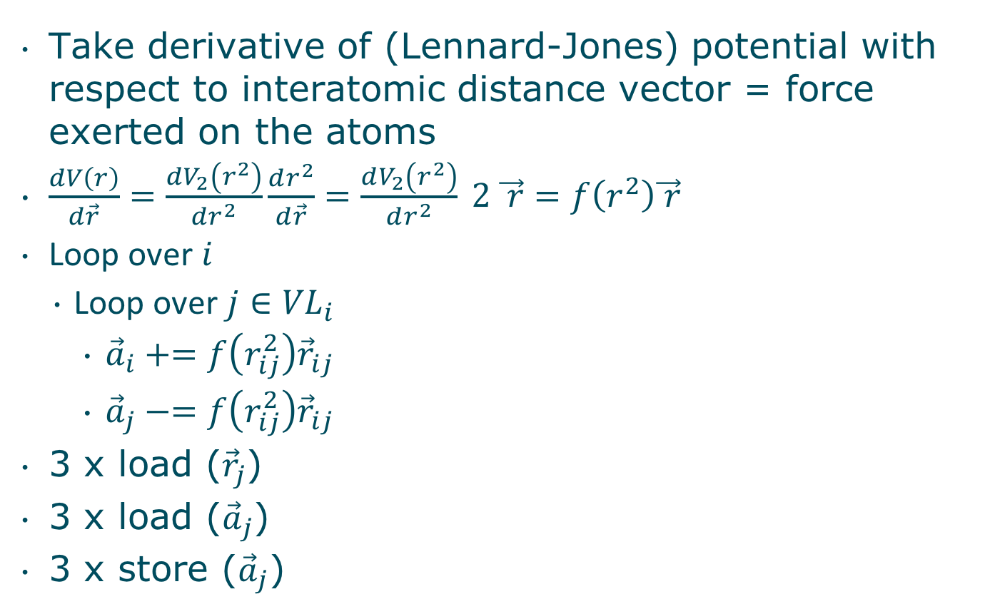
MD interaction forces
Take derivative of (Lennard-Jones) potential with respect to interatomic distance vector = force exerted on the atoms
$\frac{dV\left(r\right)}{d\vec{r}}=\frac{dV_{2}\left(r^{2}\right)}{dr^{2}}\frac{dr^{2}}{d\vec{r}}=\frac{dV_{2}\left(r^{2}\right)}{dr^{2}} 2 \vec{ r}=f\left(r^{2}\right)\vec{ r}$
Loop over $i$
Loop over $j∈{VL}_{i}$
${\vec{a}}_{i}+=f\left(r_{ij}^{2}\right){\vec{r}}_{ij}$
${\vec{a}}_{j}−=f\left(r_{ij}^{2}\right){\vec{r}}_{ij}$
3 x load (${\vec{r}}_{j}$)
3 x load (${\vec{a}}_{j}$)
3 x store (${\vec{a}}_{j}$)

Slide 92
Results
Baseline case:
N atoms
Compute interaction forces of atom 0 with all other atoms
Contiguous memory access
Bandwidth saturated

Slide 93
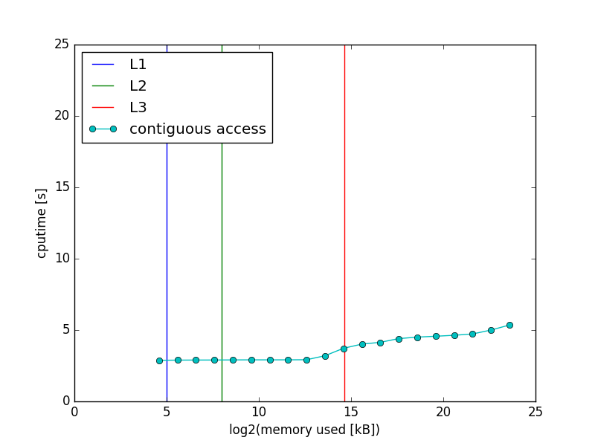
Baseline
Baseline

Slide 94
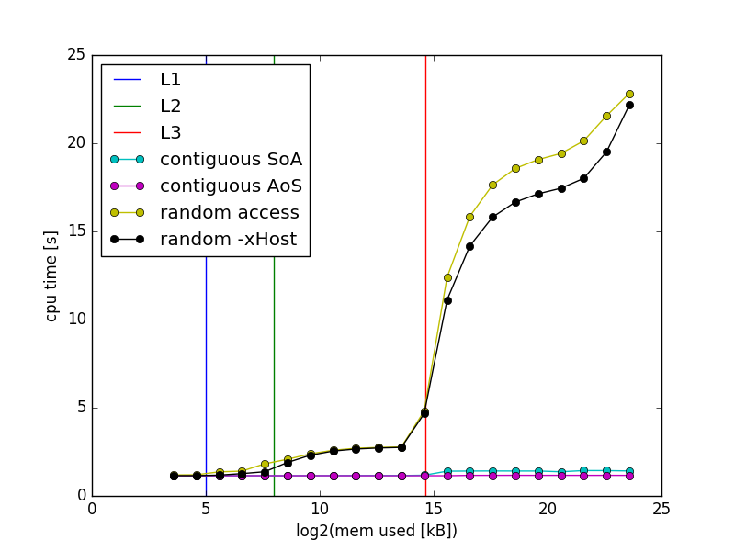
Results
MC
MD
MC: 450 10⁶ interactions/s
MD: 90 10⁶ interactions/s
In terms of interactions/s MD is about 5 times slower than MC
A bit more instructions per interaction, but MC is memory bound, that should not matter
3 times more memory access
With a read:write ratio of 2:1 the bandwidth drops from 11 GB/s to 9.5 GB/s
3x11/9.5 = 3.47
Still factor 1.44 slower than expected

Slide 95
Experiments
Three cases:
Atoms on FCC lattice
Permute the atoms (=random memory access)
Spatial sort by hilbert index
Every experiment build the Verlet list and computes the interactions
Cputime is measured only for computing the interactions
Plot result relative to baseline
90 10⁶ interactions/s

Slide 96
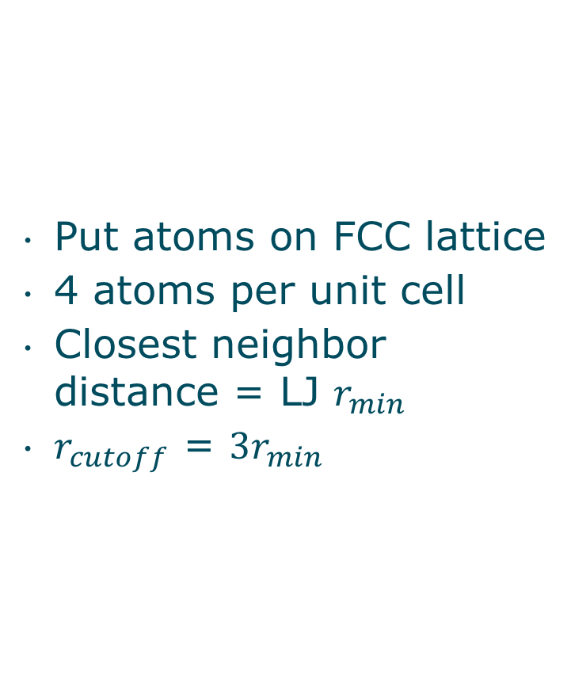
Case 1
Put atoms on FCC lattice
4 atoms per unit cell
Closest neighbor distance = LJ $r_{min}$
$r_{cutoff}$ = ${3r}_{min}$

Slide 97
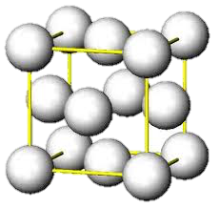
Case 1

Slide 98
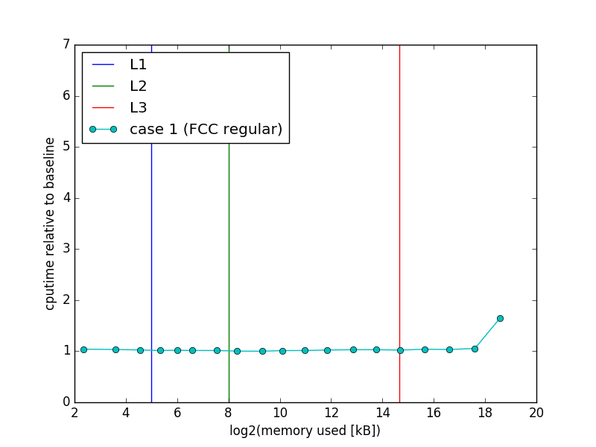
Case 1
Close to baseline

Slide 99
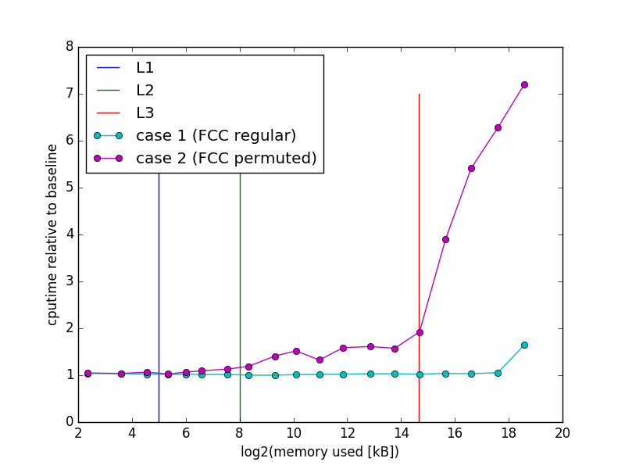
Case 2
Due to diffusion this becomes the real case pretty soon!

Slide 100
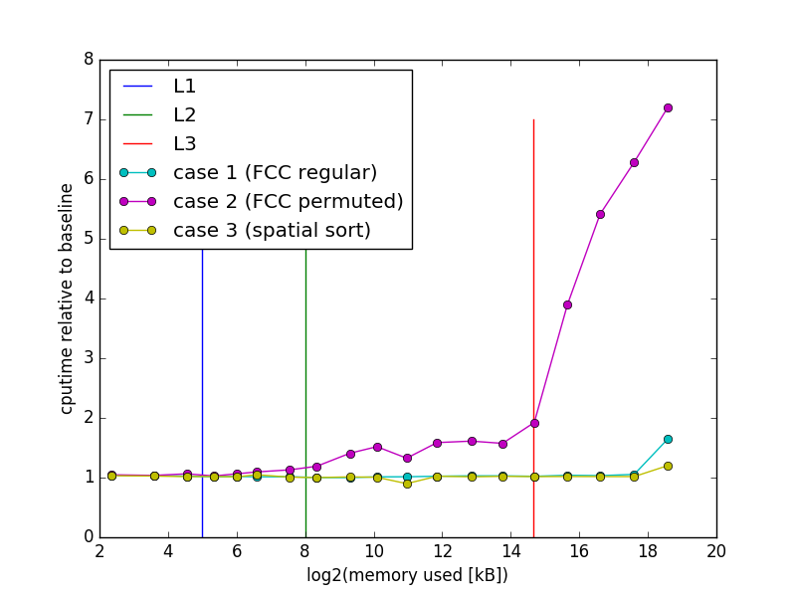
Case 3
We are back on the baseline!
Improved performance at large N
Spatial sort is relatively expensive
but the timestep and displacements are small
Cost can be amortized over many timesteps

Slide 101
Fixing the data access pattern
Sort atom property arrays (rx,ry,rz,vx,vy,vz,…) based on the Hilbert index h of the cell of the atoms (spatial sort).
Atoms which are close in space (and hence will interact) will be close in memory (and hence will be in the cache with high probability)
Build a table containing the index of the first atom in each cell, and the number of atoms in the cell (Hilbert list)
Build Verlet list from the Hilbert list (discard the latter)
Compute the interactions by looping over the Verlet list and measure the performance (e.g. interactions/s)
Integrate forces, updating velocities and positions and time
If performance degrades jump back to step 1. else continue at step 4.

Slide 102
Performance analysis
atoms : 2,13 10⁶
pairs : 162 10⁶
Ratio : 76
Pairs computed per second : 88.6 10⁶
B/atom: 376,5 (320B is in the verlet list)
Bandwidth = 9,5 GB/s (measured by mlc 2 reads : 1 write)
maximum atoms per second: 27.000.000 (based on bandwidth)
actual atoms per second: 1.160.000
ratio: 0,04
flops_per_pair : 27
flops_per_atom : 2055,5
gflops_per_second: 2,39
peak performance : 11,2
ratio : 0,21
Not memory bound
Lot of flops per atom!
Not compute bound either!

Slide 103
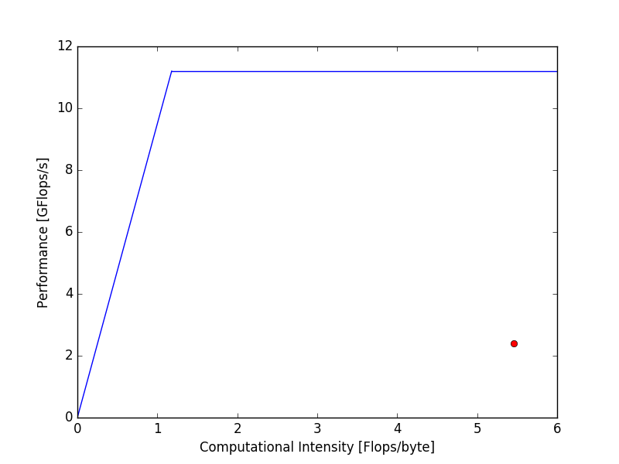
Roofline MD setting
MC
MD

Slide 104
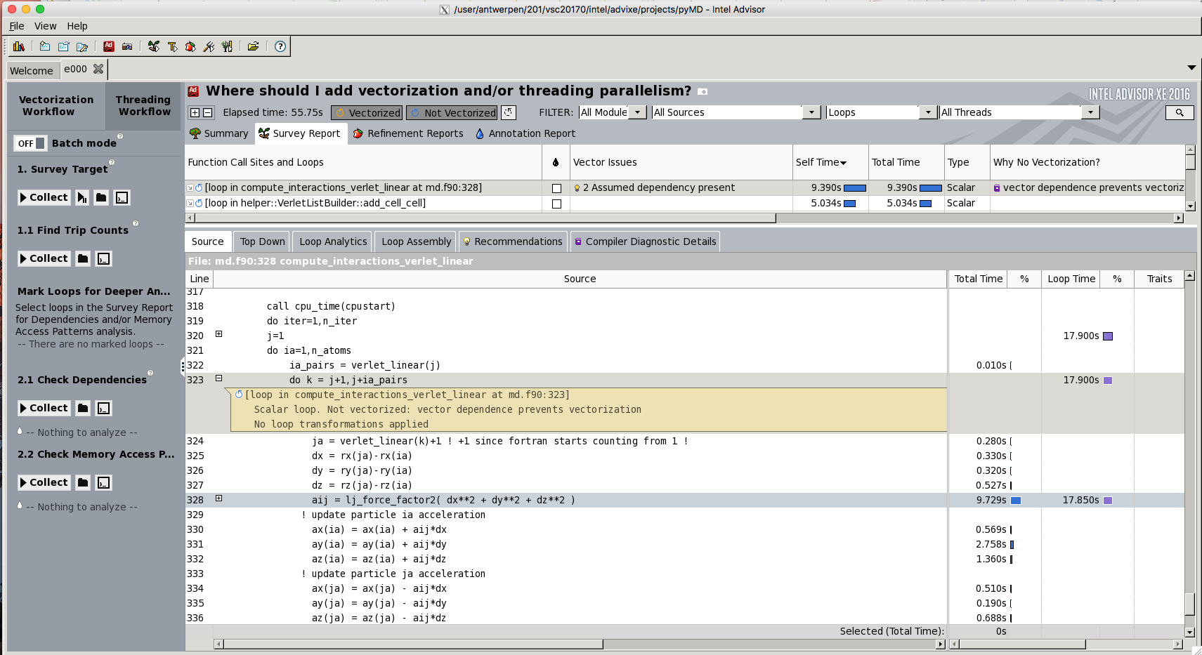
What do the intel tools tell? Advisor

Slide 105
What do the intel tools tell?
j=1
do ia=1,n_atoms
ia_pairs = verlet_linear(j) ! Size of the Verlet list of atom ia
!DIR$ SIMD
do k = j+1,j+ia_pairs
ja = verlet_linear(k)+1 ! +1 since Fortran starts counting from 1 !
dx = rx(ja)-rx(ia)
dy = ry(ja)-ry(ia)
dz = rz(ja)-rz(ia)
aij = lj_force_factor2( dx**2 + dy**2 + dz**2 )
! update particle ia acceleration
ax(ia) = ax(ia) + aij*dx
ay(ia) = ay(ia) + aij*dy
az(ia) = az(ia) + aij*dz
! update particle ja acceleration
ax(ja) = ax(ja) - aij*dx
ay(ja) = ay(ja) - aij*dy
az(ja) = az(ja) - aij*dz
enddo
j = j + 1 + ia_pairs
enddo
Ignore assumed dependencies and vectorize the loop
SIMD vectorization means that you update ax(aj) for 4 successive ja values (also ay(aj) and az(ja))
The compiler cannot know that the ja are different
Assumed dependency
We know that the ja are different by construction of the Verlet list
We must tell the compiler to ignore assumed dependencies

Slide 106
What do the intel tools tell?
“inserts present” = hint for gather/scatter
Filling a vector register element per element (in the case of non-contiguous elements)
AVX (highest SIMD extension available on Hopper) has no built-in support for gather/scatter
AVX2 has special instructions for gather/scatter
Available on BrENIAC
Available on successor of Turing

Slide 107
j=1
do ia=1,n_atoms
ia_pairs = verlet_linear(j) ! Size of the Verlet list of atom ia
!DIR$ SIMD
do k = j+1,j+ia_pairs
ja = verlet_linear(k)+1 ! +1 since Fortran starts counting from 1 !
dx = rx(ja) - rx(ia)
dy = ry(ja) - ry(ia)
dz = rz(ja) - rz(ia)
aij = lj_force_factor2( dx**2 + dy**2 + dz**2 )
! update particle ia acceleration
ax(ia) = ax(ia) + aij*dx
ay(ia) = ay(ia) + aij*dy
az(ia) = az(ia) + aij*dz
! update particle ja acceleration
ax(ja) = ax(ja) - aij*dx
ay(ja) = ay(ja) - aij*dy
az(ja) = az(ja) - aij*dz
enddo
j = j + 1 + ia_pairs
enddo
Gather operation moving rx(ja), ry(ja), rz(ja)
for 4 successive ja values into the vector registers
Scatter operation moving
ax(ja), ay(ja), az(ja)
for 4 successive ja values
out of the vector registers.

Slide 108
C = A+B
No gather/scatter, 4 successive items moved as a block into/out of vector registers
A
B
A
B
Vector registers
memory
vadd
C
C

Slide 109
C = A+B
No gather/scatter, 4 successive items moved as a block into/out of vector registers
C = A+B
No gather/scatter
A
B
A
B
Vector registers
memory
vadd
C
C

Slide 110
C = A+B
gather/scatter, items moved one by one into/out of vector registers
A
B
A
B
Vector registers
memory
vadd
C
C

Slide 111
What do the intel tools tell?
LLC misses 0.008 %
LJ_force_factor2 0.59 cpi
Compute_interactions 0.77 cpi
cpi at best 0.25
cpi ≤ 1 considered acceptable in HPC
There is still room for improvement
No more low hanging fruit, though

Slide 112
Beyond auto-vectorisation
Assembly code
Architecture dependent code
Libraries for writing explicit vector code
Architecture independent code
C++ only
Vc (github.com/VcDevel/Vc)
Boost.simd (github.com/NumScale/boost.simd)
Similar performance
Rewrite algorithm in terms of vector operations rather than scalar operations

Slide 113
Beyond auto-vectorisation
Gain:
120–127 10⁶ interactions per second (instead of 90 10⁶)
30% improvement
Not bad, but not effortless (took me about 1½ week)
AVX2 will probably do even better
Coding details in other talk

Slide 114
Conclusions
Data access pattern is crucial to performance

Slide 115
Conclusions
Monte Carlo case (3N reads, no writes)
Contiguous data access:
450 10⁶ interactions/s
Bandwidth saturation (machine limit)
Random access:
Performance drops by factor 15 (cache misses, gather/scatter)

Slide 116
Conclusions
Bandwidth saturation means that the CPU is waiting for the data to arrive
Try to do more computations with the data that is available, e.g.:
Additional computations
A more complex model
Program will not run faster but will do more work in the same time

Slide 117
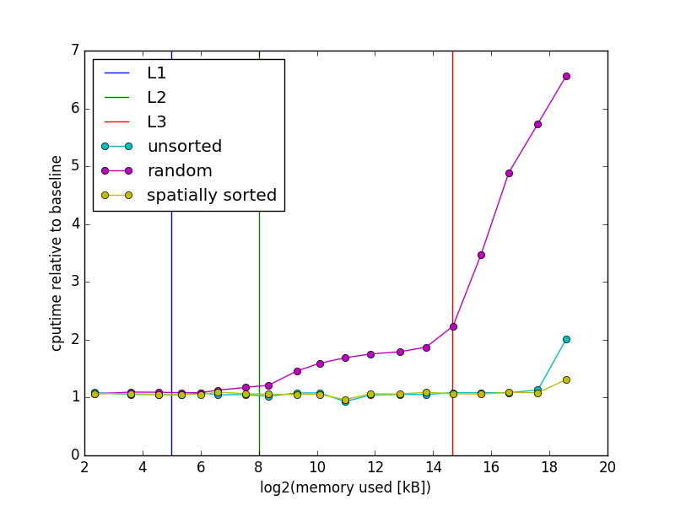
Conclusions
Molecular dynamics case (6N reads, 3N writes + VL)
Contiguous data access:
90 10⁶ interactions/s
No machine limits hit
gather/scatter
Random access:
Performance drops by factor 7
Spatial sort fixes the problem
Fixing the data access pattern is not always easy
Involves usually some form of sorting the data

Slide 118
Conclusions
Data access pattern is crucial to performance
Spatial sort using space filling curves is useful technique for fixing data access patterns

Slide 119
Conclusions
Data access pattern is crucial to performance
Spatial sort using space filling curves
Intel tools (Advisor, VTune) provide useful clues to optimizing your code
Hot spots
The nature of hot spots (data access, expensive instructions, …)
Issues with vectorization

Slide 120
Conclusions
Data access pattern is crucial to performance
Spatial sort using space filling curves is useful
Intel tools (Advisor, VTune) provide useful clues
Fortran has many advantages for programming number-crunching routines
F2py for producing python modules

Slide 121
Python/Fortran/C++
Python/Numpy
verify code correctness
generate FCC lattice
generate arrays filled with random numbers
generate permutations
zero accelerations between time steps
build Verlet list
spatial sort of atom property arrays
define coarse computational strategy and data structures
control and initialize the experiments
plot results
Fortran
Lennard-Jones potential
Lennard-Jones forces
iterate over Verlet list and compute interactions
iterate over array and compute interactions (baselines)
C++
compute hilbert indices
build Verlet list
iterate over Verlet list and compute inter–actions using simd libraries
Speedup of 1200x !
code 80%
cputime 5%
code 10%
cputime 90%
10%
cputime 5%

Slide 122
Conclusions
Data access pattern is crucial to performance
Spatial sort using space filling curves is useful
Intel tools (Advisor, VTune) provide useful clues
Fortran has many advantages
Use a simple but relevant baseline that you understand to judge the performance of your code and direct your efforts

Slide 123
Conclusions
Data access pattern is crucial to performance
Spatial sort using space filling curves is useful
Intel tools (Advisor, VTune) provide useful clues
Fortran has many advantages
Use a simple relevant baseline
Be aware of the machine limits
Bandwidth
Peak performance
Roofline model

Slide 124
Conclusions
Data access pattern is crucial to performance
Spatial sort using space filling curves is useful
Intel tools (Advisor, VTune) provide useful clues
Fortran has many advantages
Use a simple relevant baseline
Be aware of the machine limits
Simd libraries are useful
Thank you
You are always welcome to discuss your (computational) problems

Slide 125
Conclusions
Data access pattern is crucial to performance
Spatial sort using space filling curves is useful
Intel tools (Advisor, VTune) provide useful clues
Fortran has many advantages
Use a simple relevant baseline
Be aware of the machine limits
SIMD libraries are useful
Vc, Boost.simd

